Slide 1

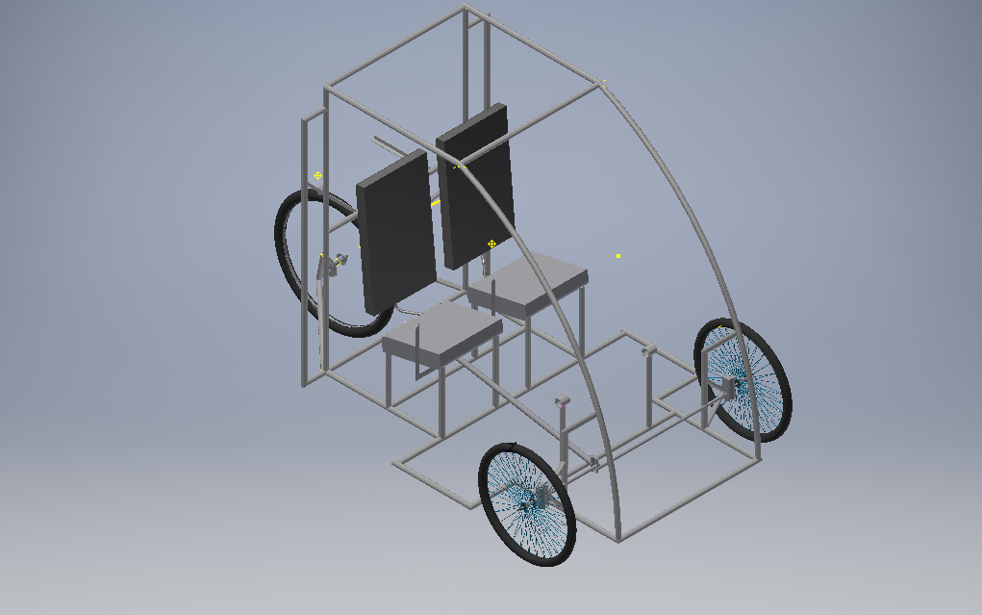

DAYANANDA SAGAR COLLEGE OF ENGINEERING
EFFICYCLE
2017

Slide 2

About Efficycle
“EFFI-CYCLE” derived from Efficient-Cycle .
It’s a competition to design and fabricate a three wheel configuration(tadpole) vehicle powered by human-electric hybrid power.
The vehicle must be aerodynamic, engineered for performance, safety and ergonomically designed.
Competition will be conducted by SAE NIS on 1st, 2nd and 3rd November 2017 in Lovely Professional university , Jalandhar, Punjab.

Slide 3


About Us
We are Bangalore based team from Dayanada Sagar College of Engineering called Vegam.
We are team consisting of 9 students from Mechanical , Automobile and Electrical department .
We are supported by our HOD and guided by Professor Nandakumar Basavaraju .

Slide 4


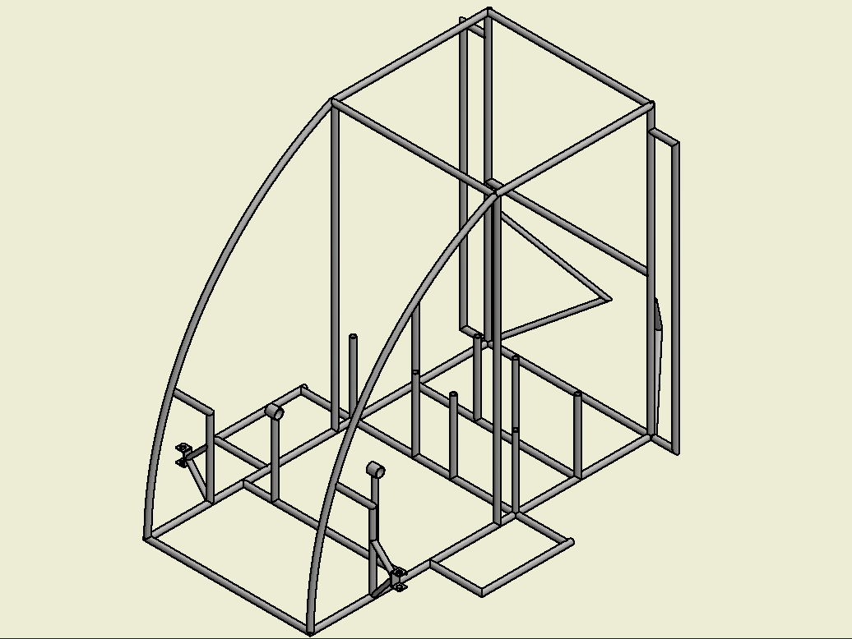
Vehicle Frame Design

Slide 5

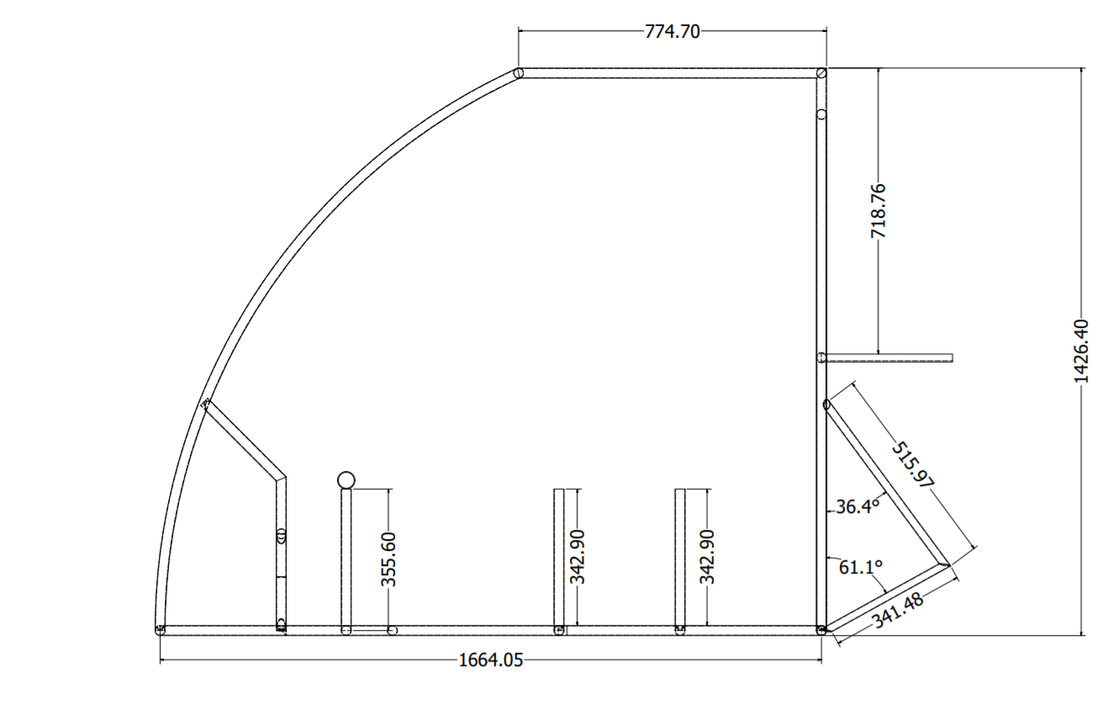
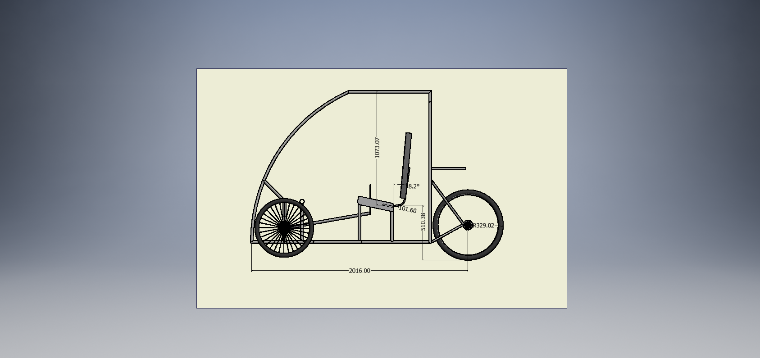
Frame CAD model

Slide 6
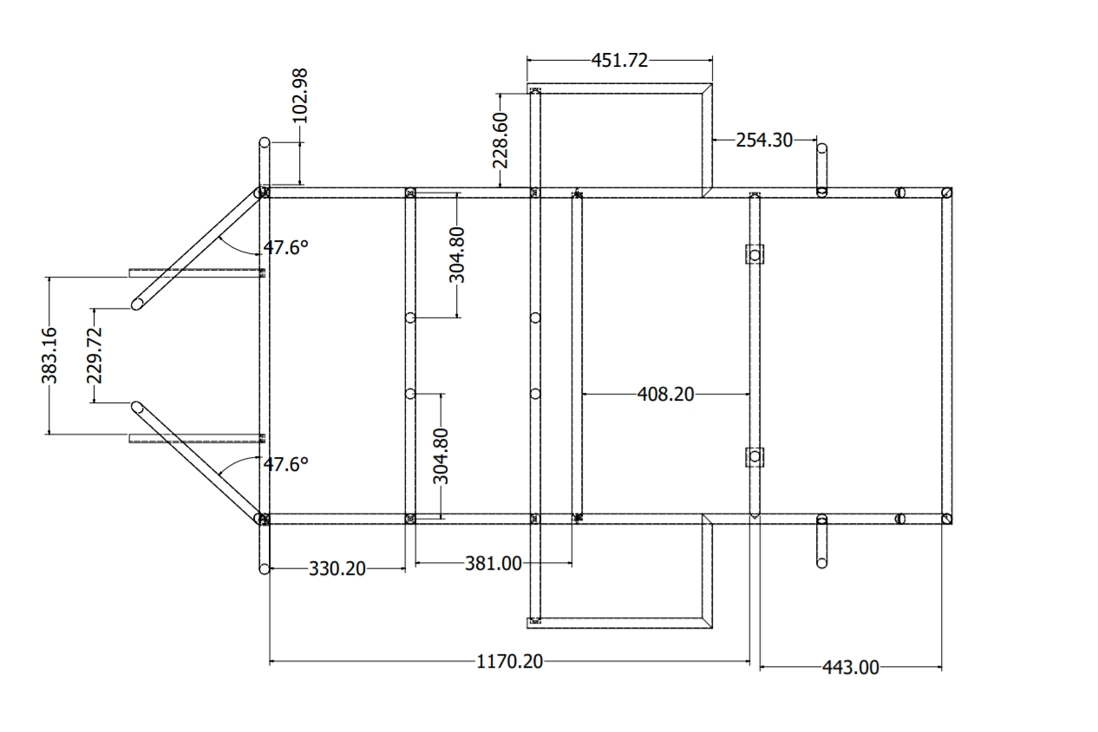
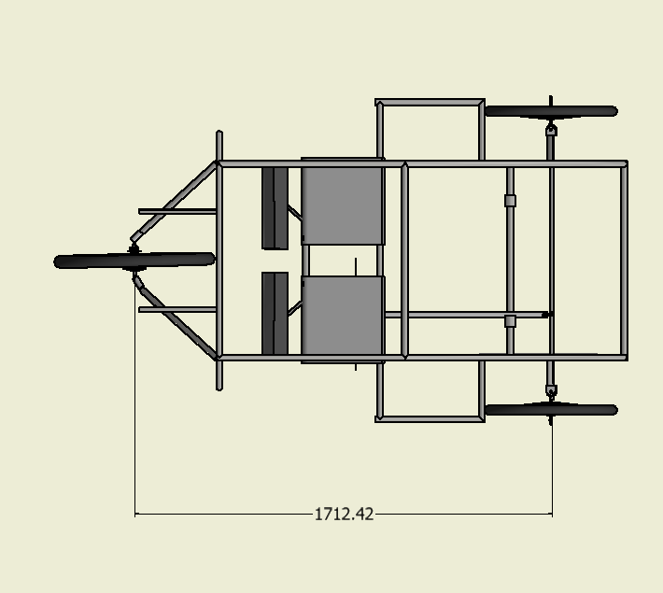
Frame CAD model contd..

Slide 7
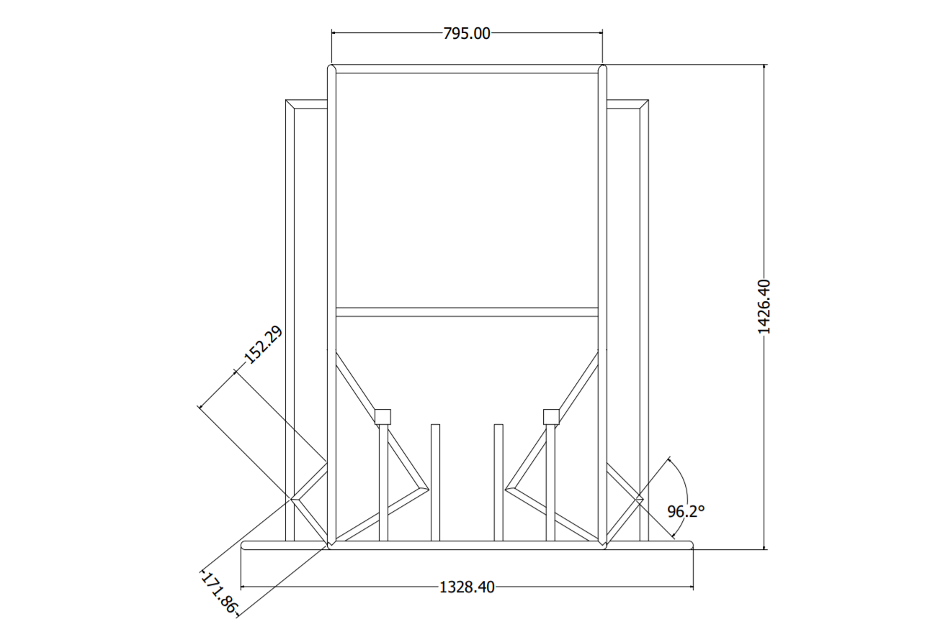
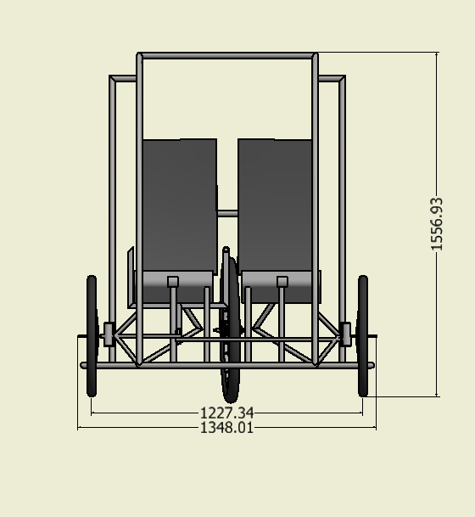
Frame CAD model contd..

Slide 8

CAD / CAE report
Particulars | AISI 1018 | AISI 3074 | AISI 1020
Thickness (mm) | 2 | 2 | 2
Outer diameter (mm) | 25.4 | 25.4 | 25.4
Yield strength (MPa) | 365 | 373 | 350
Ultimate Strength (MPa) | 440 | 409 | 420
Density(g/cc) | 7.87 | 7.87 | 7.87
Modulus of Elasticity (GPa) | 205 | 210 | 205
Carbon content (%) | 0.14% | 0.05% | 0
Weld ability | Good | Good | Good
Corrosion resistance | Good | Excellent | Good
Lead time for delivery (days) | 7 | 5 | 8
Availability | Easily Available | Easily Available | Not Easily Available
Cost Rs/m | 105 | 78 | 92
FRAME MATERIAL OPTIONS
STEELALLOY (AISI 1018 ) CROSS-SECTION TYPE; 25.4 X 21.4 X 2
STEEL ALLOY (AISI 3074) CROSS-SECTION TYPE; 25.4 X 21.4 X 2
STEEL ALLOY (AISI 1020) CROSS-SECTION TYPE; 25.4 X 21.4 X 2
WHERE;
A = OUTER DIA FOR CIRCULAR SECTION, BIGGER SIDE FOR RECTANGULAR SECTION, MAJOR AXIS IN CASE OF ELLIPTICAL SECTION ETC. (ALL DIMENSIONS IN MM OR INCH)
B= INNER DIA FOR CIRCULAR SECTION, SMALLER SIDE FOR RECTANGULAR SECTION, MINOR AXIS IN CASE OF ELLIPTICAL SECTION ETC. (ALL DIMENSIONS IN MM ON INCH)
T= WALL THICKNESS IN MM OR INCH.

Slide 9
CAD / CAE report continued…
calculation of bending strength and bending stiffness
AISI 3074
Outer Dia -25.4mm
Inner Dia 21.4mm
Thickness 2mm
σ_{y} =373 MPa
E = 210GPa
M = (σ_{y} *I)/c =(373*10136.745)/11.7 = 323162.8N/mm²
I = (π(d_{o}⁴ –d_{i}⁴))/64 =(3.14(25.4⁴-21.4⁴))/64 =10136.745 mm⁴
C = (d_{o}-d_{i})/2/2=(21.4-21.4)/2/2=11.7 mm
Bending Stiffness = E*I =2.10 *10⁵ *323162.8 = 2128.71*10⁶Nmm²
Particulars | AISI 1018 | AISI 3074 | AISI 1020
Bending strength (N/mm²) | 316231.7 | 323162.8 | 303235.96
Bending stiffness (N/mm) | 2078.03*10⁶ | 2128.71*10⁶ | 1064.35 *10⁶

Slide 10

Various events
Technical Inspection
Rulebook/Safety Compliance Check
‘Figure of 8’ Test
Electric Drive Inspection
Brake Test
Build Quality Check
Weight Measurement
Static Evaluations
Design Evaluation
Cost Evaluation
Build Quality Evaluation
CAE Award Evaluation
Innovation Award Evaluation
3) Dynamic Tests
Acceleration Test
Gradient Simulator Test
Drive Excellence Test
Endurance Run

Slide 11
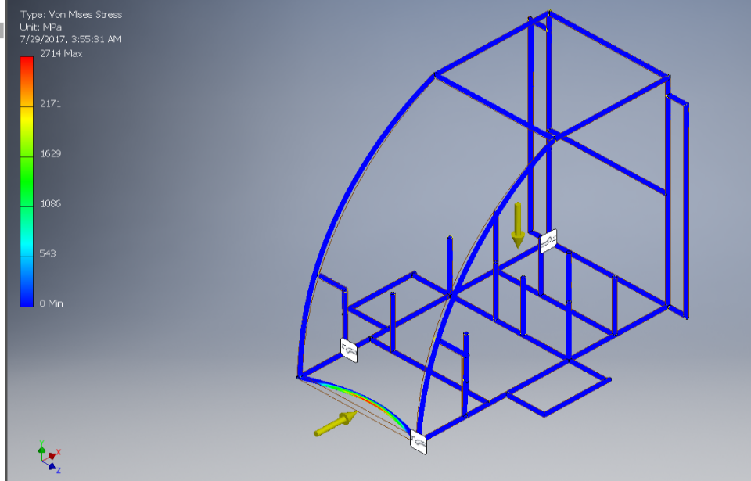
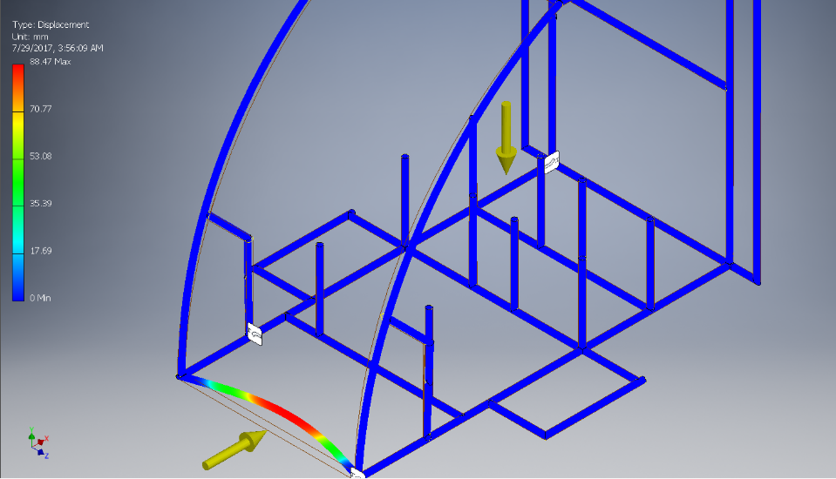
CAD / CAE report continued…
Material-2 (AISI 3074/25.4*21.4x2)
a) Assumption & Considerations:
Total mass of the vehicle including drivers, pay load being 400 kg
The vehicle was moving at 40 km/h while impact
While analysis , the force is applied on the front while the rear was kept rigid .
Impact timing being 0.13 seconds.
b) Calculation of Impact Forces:
Total mass of the vehicle, M =400N
Initial velocity before impact, V_{initial} = 9.72 m/s
Final velocity after impact, V_{final} will be zero.
Impact time = 0.13 seconds
Work done = change in kinetic energies.
From work energy principal,
Work done = change in kinetic energies W = (0.5 × M × V_{fina}l² - 0.5 × M × V _{initial}² )
│W│ = │- 0.5 × M × v_{initial}²│ =│- 0.5 × 400 × 9.72²│ = 18895.68 Nm
Now, Work done = force × displacement= F × s …… (1) s = impact time × v_{maximum} = 0.13 ×9.72 = 1.263 m So, from (1) we get, F = W/ s = 18895.68 / 1.263 = 14960.94N
c) Analysis Results:
Max displacement =18mm
Max Stress = 271 MPa
FOS=1.73

Slide 12
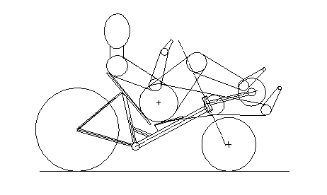
Key Features of our vehicle
Ergonomically designed
Regenerative breaking will be incorporated
Designed For easy maneuverability
Safe
Eco friendly
Easy to ride

Slide 13
Cost Analysis
Particulars | Cost (Rs)
SAE Efficycle registration fees | 30000
Motor and battery | 22000
Roll Cage Material | 3000
Wheels and Tires | 2500
Braking System | 3180
Steering System | 3000
Gear Train | 2000
Electrical Systems | 3000
Fabrication | 7000
Safety Equipment | 5000
Paint | 1500
Body panels and Fasteners | 1000
Logistics | 15,000
Total | 98180

Slide 14



SPONSORSHIP CATEGORY
DIAMOND
SPONSORS
₹60,000-₹45,000
GOLD SPONSORS
₹45,000- ₹20,000
SILVER SPONSORS
₹20,000- ₹10,000

Slide 15
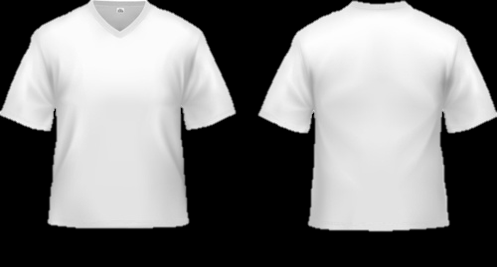
DIAMOND SPONSORS ₹60,000-₹40,000
Advertising sponsored company on the vehicle
Advertising through display hoardings
Advertising on T-Shirt
Special mention in all the department events
Special mention in the team brochure

Slide 16
GOLD SPONSORS ₹50,000- ₹80,000
Advertising sponsored company on the vehicle
Advertising through display hoardings
Advertising on T-Shirt
Special mention in all the department events

Slide 17
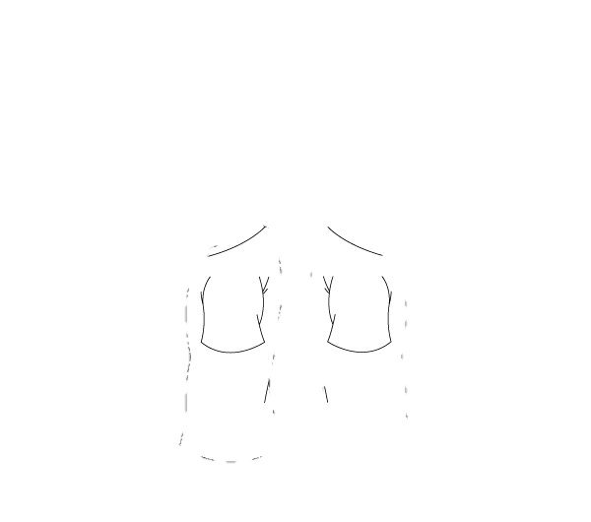
SILVER SPONSORS ₹20,000- ₹10,000
Advertising sponsored company on the vehicle
Advertising through display hoardings
Advertising on T-Shirt
Mention in all the department events

Slide 18
OTHER SPONSORS UPTO ₹ 10,000
Advertising sponsored company on the vehicle
Advertising through display hoardings
Mention in all the department events

Slide 19
Thank You !

